Slide 1
Production Planning and Execution (PP)
Curriculum: Introduction to S/4HANA using Global Bike

Slide 2
GBI 4.1 on S/4HANA 2020 / June 2022
S/4HANA 2020
Fiori 3.0
Global Bike
No prerequisites needed

Slide 3
Bret Wagner
Stefan Weidner
Babett Ruß
Beginner

Slide 4
Understand a manufacturing process cycle
Get familiar with the basics of a production plan

Slide 5
Functionality
SAP divides production into multiple processes
  Production Planning
  Manufacturing Execution
    Discrete Manufacturing
    Repetitive Manufacturing
    KANBAN
  Production – Process Industries
    Integrated planning tool for batch-orientated process manufacturing
    Design primarily for chemical, pharmaceutical, food and beverage industries along with batch-oriented electronics

Slide 6
Unit Overview
PP Organizational Structure
PP Master Data
PP Processes
  Material Planning
  Production Planning
  Manufacturing Execution Process

Slide 7
PP Organizational Structure
Client
  An independent environment in the system
Company Code
  Smallest org unit for which you can maintain a legal set of books
Plant
  Operating area or branch within a company
    Manufacturing, distribution, purchasing or maintenance facility
Storage Location
  An organizational unit allowing differentiation between the various stocks of a material in a plant
Work Center Locations (in SAP system → master data)
  An organizational unit that defines where and when an operation is performed
  Has an available capacity
  Activities performed are valuated by charge rates, which are determined by cost centers and activity types.
  Can be machines, people, production lines or groups of tradespeople

Slide 8
Global Bike Structure for Production Planning
Global Bike
Client
Global Bike Inc.
Global Bike Germany GmbH
Company
Code
Dallas
Heidelberg
Plant
Raw Materials
Raw Materials
Semi-fin. Goods
Semi-fin. Goods
Storage
Location
Finished Goods
Finished Goods
Miscellaneous
Miscellaneous
Assembly
Assembly
Packaging
Packaging
(Work Center Location)
Inspection
Inspection

Slide 9
GBI Enterprise Structure in SAP ERP (Logistics)
Shipping Point
DL00
MI00
SD00
TO00
HD00
HH00
PE00
RM00
TG00
TG00
TG00
RM00
TG00
TG00
Storage
Location
SF00
FG00
FG00
FG00
SF00
FG00
FG00
FG00
MI00
MI00
MI00
FG00
MI00
MI00
MI00
MI00
Central Purchasing Organization (global) GL00
Purchasing Org. US00
CA00
PO DE00
AU00
Purchasing Group North America
N00
PGr Europe
E00
Asia
A00
Dallas
DL00
Miami
MI00
S. Diego
SD00
Toronto
TO00
Heidelb.
HD00
Hamburg
HH00
Perth
PE00
Plant
CC US00
CA00
CC DE00
AU00
Company Code
Client GBI

Slide 10
PP Master Data
Material
Bill of Materials (BOM)
Routing
  BOM and routing are like a cooking recipe
  BOM = ingredients
  Routing = steps in the recipe
Work Center
Product Group

Slide 11
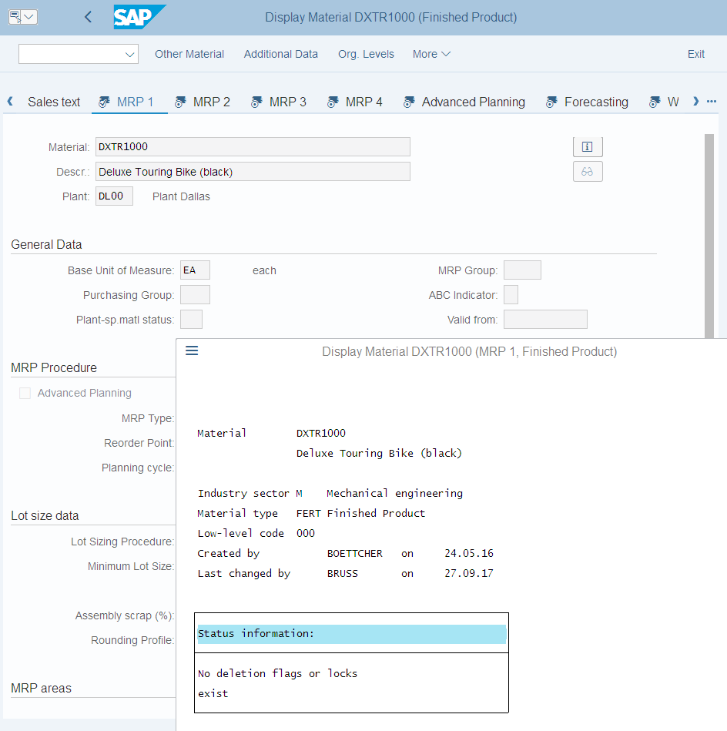
Material Master Record

Slide 12
Bill of Materials (BOM)
List of components that make up a product or assembly
Wheel Assembly
  Tire
  Tube
  Wheel
  Hex Nut
  Lock Washer
  Socket Head Bolt
Frame
Derailleur Gear Assembly
Seat Kit
Handle Bar
Pedal Assembly
Chain
Brake Kit
Warranty Document
Packaging
Notes:
Forecasting should be done primarily for end-item demand. In manufacturing situations, this means there is no real need for forecasting component parts which make up the final item. When production quantities for the end item have been determined, component demand can be computed based on the production plan of the end item and knowledge of the bill of materials (BOM).

Slide 13
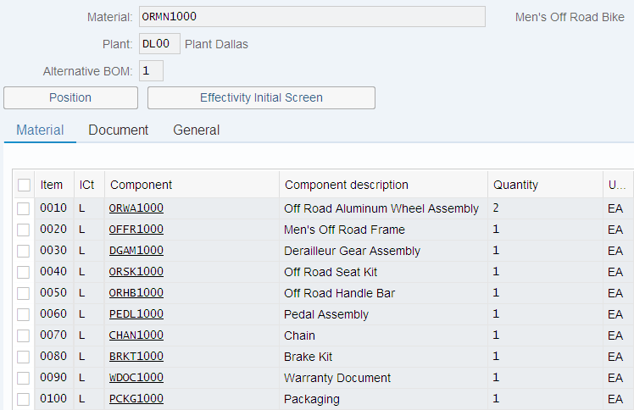
Bill of Materials (BOM)
Single-Level
Single-Level
Finished Bike
Wheel Assembly
Pedal Assembly
Frame
Chain
Derailleur Gear
Assembly
Brake Kit
Seat Kit
Warranty Doc.
Handle Bar
Packaging

Slide 14
Bill of Materials (BOM)
Multi-Level
Single-Level
Single-Level vs. Multi-Level
Finished Bike
Single-Level
Wheel
Frame
Derailleur
Seat
Handle Bar
Pedal
Chain
Brake
Doc.
Pack.
Tire
Tube
Wheel
Hex nut
Lock
Bolt

Slide 15
Bill of Materials (BOM)
Variant Bill of Materials (BOM)
  Several products with a large proportion of identical parts.
Single-Level
Deluxe Bike (red)
Single-Level
Professional Bike (black)
Aluminum Wheel
Pedal Assembly
Carbon Wheel
Pedal Assembly
Frame red
Chain
Frame black
Chain
Derailleur Gear
Assembly
Brake Kit
Derailleur Gear
Assembly
Brake Kit
Seat Kit
Warranty Doc.
Seat Kit
Warranty Doc.
Handle Bar
Packaging
Handle Bar
Packaging

Slide 16
BOM – Item Categories
An object that defines items in a BOM according to criteria, such as the object type of the component, for example, material master record or document info record.
The item category controls the following:
  Screen sequence
  Field selection
  Default values
  Material entry
  Inventory management
  Subitems
Item Categories
  Stock item
  Non-stock item
  Variable material – Sheet of steel
  Document item
  Text item
Notes:
Item Categories
Stock Item – place a reservation and removed from stock when needed
Non-Stock Item – Purchase Requisition will need to be created for the item
Document Item – CAD drawing, Engineering Documents, etc

Slide 17
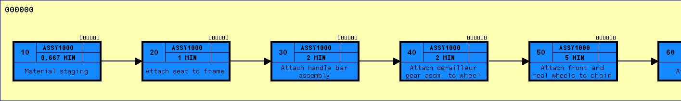
Routing
Routings enable the planning of the production of materials (products)
Routings are used as a template for production orders and run schedules
Routings are also used as a basis for product costing
Series of sequential steps (operations) that must be carried out to produce a given product
Routings contain:
  What, Where, When, How
Notes:
Routings enable you to plan the production of materials (products). Therefore, routings are used as a template for production orders and run schedules as well as a basis for product costing.
A routing is a description of which operations (process steps) have to be carried out and in which order to produce a material (product). As well as information about the operations and the order in which they are carried out, a routing also contains details about the work centers at which they are carried out as well as about the required production resources and tools (includes jigs and fixtures). Standard values for the execution of individual operations are also saved in routings.
In a routing you plan
- The operations (work steps) to be carried out during production
- The activities to be performed in the operations as a basis for determining dates, capacity requirements, and costs
- The use of materials during production
- The use of work centers
- The quality checks to be carried out during production

Slide 18

Routing
Routing – Operation 20
  Attach seat to frame
Work Center – ASSY1000
  Assembly Work Center
Time
  1 minute

Slide 19
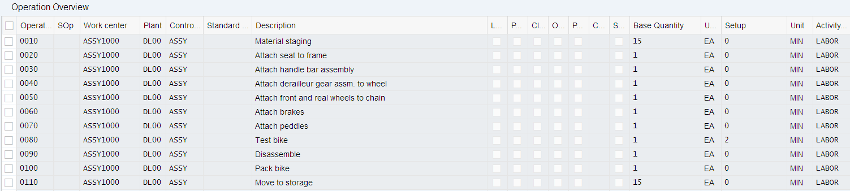
Routing
Routing for Finished Bike
Operation
Plant
Description
Activity Type - unit in a controlling area that classifies the activities performed in a cost center. Examples in production cost centers are machine hours or finished units.
Work Center
Control Key - key that specifies how an operation or a sub-operation is processed in functions such as orders, costing or capacity planning.
Time and Unit of Measure

Slide 20
Work Center
A location within a plant where Value-added work (operations or activities) is performed
  Work Centers can represent
    People or Groups of people
    Machines or Groups of machines
    Assembly Lines
Work Center used to define capacities
  Labor
  Machine
  Output
  Emissions
Capacities used in
  Capacity requirements planning (CRP)
  Detailed scheduling
  Costing

Slide 21
Work Center
Work Centers capture and use the following Resource related data
  Basic Data
    Person Responsible, Location of Work Center
  Scheduling Information
    Queues and Move Times (interoperation), Formula Keys
  Costing Data
    Cost Center, Activity Types
  Personnel Data
    People, Positions, Qualifications
  Capacity Planning
    Available Capacity, Formulas, Operating Time
  Default Data
    Control Key, Standard Text Key
Notes:
Data in work centers is used for
- Scheduling - Operating times and formulas are entered in the work center, so that the duration of an operation can be calculated.
- Costing - Formulas are entered in the work center, so that the costs of an operation can be calculated. A work center is also assigned to a cost center.
- Capacity planning - The available capacity and formulas for calculating capacity requirements are entered in the work center.
- Simplifying operation maintenance - Various default values for operations can be entered in the work center

Slide 22
Product Group
Aggregate planning that groups together materials or other product groups (Product Families)
Multi- or Single-Level Product Groups
  The lowest level must always consist of materials

Slide 23
PP Processes
Production Planning & Execution
  Forecasting
  Sales and Operations Planning (SOP)
  Demand Management
  Master Production Scheduling (MPS)
  Material Requirement Planning (MRP)
Production Order

Slide 24
Production Planning & Execution
SIS
Forecasting
CO/PA
Sales & Operations
Planning
Strategic Planning
Demand
Management
MPS
Detailed Planning
MRP
Manufacturing
Execution
Procurement
Process
Order
Settlement
Manufacturing Execution

Slide 25
Production Planning & Execution
Players in the Game
  Strategic Planning
    CEO, COO, CIO, CFO, Controller, Marketing Director
  Detailed Planning
    Line Managers, Production Scheduler, MRP Controller, Capacity Planners
  Execution
    Line Workers, Shop Floor Supervisors
SIS
Forecasting
CO/PA
Sales & Operations
Planning
Strategic Planning
Demand
Management
MPS
Detailed Planning
MRP
Manufacturing
Execution
Procurement
Process
Order
Settlement
Manufacturing Execution

Slide 26
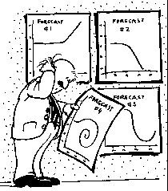
Forecasting
Forecasting is the foundation of a reliable SOP
Accurate forecasts are essential in the manufacturing sector
Overstocked & understocked warehouses result in the same issue: A loss in profits.
Forecasts are ALWAYS WRONG
Notes:
Supply chain planning, to a large degree, starts with forecasting. Matching supply and demand is an important goal for most firms and is at the heart of operational planning. It is also of significant importance as the overly optimistic Cisco foand in 2001 when it took a $2.2 Billion inventory write-down because of their ability to “forecast demand with near-scientific precision” 1. Since most production systems can’t respond to consumer demand instantaneously, some estimate, or forecast, of future demand is required so that the efficient and effective operational plans can be made.
Forecasts are always wrong, but some are “more wrong” than others. Forecasting the demand for innovative products, fashion goods, and the like is generally more difficult than forecasting demand for more “commodity-like” products that are sold on a daily basis. Aggregate forecasts of a group of similar products are generally more accurate than individual forecasts of the individual products that make up the group. Finally, the longer the forecast into the future, the less reliable the forecast will be.

Slide 27
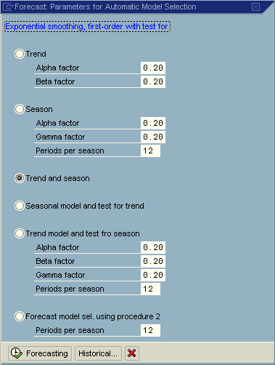
Forecasting
Forecasting Models
  Trend
  Seasonal
  Trend and Seasonal
  Constant
Selecting a Model
  Automatically
  Manually

Slide 28
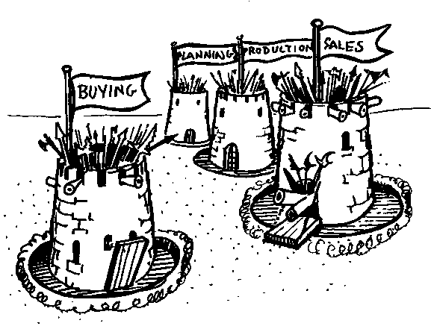
Sales and Operations Planning (SOP)
Information Origination
  Sales
  Marketing
  Manufacturing
  Accounting
  Human Resources
  Purchasing
Intra-firm Collaboration
  Institutional Common Sense

Slide 29
Sales and Operations Planning (SOP)
Flexible forecasting and planning tool
Usually consists of three layers:
  Sales Plan
  Production Plan
  Rough Cut Capacity Plan
Planned at an aggregate level in time buckets

Slide 30
Demand Management
The planning of requirement quantities and requirement dates for finished products and important assemblies
Definition of the strategy for planning and producing or procuring a finished product
Link between Strategic Planning (SOP) & Detailed Planning (MPS/MRP)
Demand management can be done manually or based on previous planning results such as sales planning, SOP, and forecast.
The results of Demand Management is called the Demand Program, it is generated from our independent requirements - PIR - Planned Independent Requirements and CIR - Customer Independent Requirements
Notes:
Aggregating forecasts across multiple items reduces forecasting errors. A clothing store, for instance, might be able to estimate within a pretty narrow range what the demand will be for men’s dress shirts. But when that store tries to estimate the demand for individual styles, colors, and sizes of shirts, the accuracy of their forecasts will be considerably worse. Firms handle this kind of forecasting problem usually in one of three ways; they either forecast from the bottom up, from the top down, or they start in the middle and work both up and down. The “top down” forecast essentially estimates total sales demand and then divides those sales dollars level by level until the stock keeping unit (SKU) is reached. The “bottom up” method, as one might expect, starts with forecasts at the SKU level and then aggregates those demand estimates level by level to reach a company–level forecast. Another method, one might call the “in-between” method, starts forecasts at the category level (like men’s dress shirts), and then works up to determine store sales and works down to divide up the forecast into styles, colors and SKUs.

Slide 31
Demand Management
Forecast
Sales
Planned
Independent
Requirements
Customer
Independent
Requirements
Demand
Program
MPS / MRP

Slide 32
Planning Strategies
Planning strategies represent the business procedures for
  The planning of production quantities
  Dates
Wide range of strategies
Multiple types of planning strategies based upon environment
  Make-To-Stock (MTS)
  Make-To-order (MTO)
    Driven by sales orders
  Configurable materials
    Mass customization of one
  Assembly orders
Notes:
Planning strategies represent the business procedures for the planning of production quantities and dates. A wide range of production planning strategies are available in the SAP R/3 System, offering a large number of different options ranging from pure make-to-order production to make-to-stock production. Depending on the strategy you choose, you can:
Use sales orders and/or sales forecast values to create the demand program
Move the stocking level down to the assembly level so that final assembly is triggered by the incoming sales order
Carry out Demand Management specifically for the assembly
Strategies for Make-to-Stock Production
Purpose
The planning strategies explained in this section are designed for planning procurement (production or purchasing) of components by planning the final products. If you can plan at component level more easily.
Prerequisites
Choose a make-to-stock strategy, if:
The materials are not segregated. In other words, they are not assigned to specific sales orders.
Costs need to be tracked at material level, and not at sales order level.
Strategies for Planning Components
Purpose
The planning strategies explained in this section are designed for planning the procurement (production or purchasing) of components by planning the components themselves. This is particularly useful in the following cases:
There is a variety of finished products (possibly with an irregular demand pattern where planning is not possible).
The finished products are consumption-based.
The overall purpose of planning at component level is to procure components to stock (without sales orders) in order to react to customer demand as quickly as possible.
Prerequisites
Choose a strategy for planning components, if:
The components are not segregated; that is, they are not uniquely linked at specific orders.
Costs should be tracked at component (material) level and not at order level.

Slide 33
Planning Strategy for Make-to-Stock
Planning takes place using Independent Requirements
Sales are covered by make-to-stock inventory
Strategies
  10 – Net Requirements Planning
  11 – Gross Requirements Planning
  30 – Production by Lot Size
  40 – Planning with Final Assembly
Notes:
Strategies for Make-to-Order (MTO) Production
Purpose
The planning strategies explained in this section are designed for the production of a material for a specific individual sales order. In other words, you do not want to produce finished products until you receive a sales order. This means that make-to-order strategies always support a very close customer-vendor relationship, because your sales orders are closely linked to production.
The same relationship exists between the sales order and production that exists in a make-to-order environment. Make-to-order is also used in the following environments.
Production using variant configuration
Assemble-to-order
Prerequisites
Choose a make-to-order strategy, if:
The materials are segregated. In other words, they are uniquely assigned to specific sales orders.
Costs must be tracked at sales order level and not on material level.
Strategies for Configurable Materials
Definition
A configurable material is a material for which different variants are possible.
The strategies for configurable materials allow you to plan products with an almost unlimited number of possible combinations of characteristics and combination value keys. Use these strategies if you want to plan a product that uses a feasible combination of characteristic values and that does not include final assembly. Typical examples of such products are cars, elevators, forklifts, trucks, buses.
Assemble-to-order
An assemble-to-order environment is one in which the product or service is assembled on receipt of the sales order. Key components are planned or stocked in anticipation of the sales order. Receipt of the order initiates assembly of the customized product. Assemble-to-order is useful where a large number of finished products can be assembled from common components.

Slide 34
Planning Strategy for Make-to-Order
Planning takes place using Customer Orders
Sales are covered by make-to-order production
Strategies
  20 – Make to Order Production
  50 – Planning without Final Assembly
  60 – Planning with Planning Material

Slide 35
Master Production Scheduling (MPS)
MPS allows a company to distinguish planning methods between materials that have a strong influence on profit or use critical resources and those that do not
Notes:
Using MPS you can carefully plan important parts or bottleneck parts in a separate planning run
at the highest BOM level before the planning results have an effect on all of the production levels.

Slide 36
Material Requirement Planning (MRP)
In MRP, the system calculates the net requirements while considering available warehouse stock and scheduled receipts from purchasing and production
During MRP, all levels of the bill of material are planned
The output of MRP is a detailed production and/or purchasing plan
Detailed planning level
  Execute primary functions
  Monitor inventory stocks
  Determine material needs
    Quantity
    Timing
  Generate purchase or production orders
Notes:
The central role of MRP is to monitor stocks and in particular, to automatically create procurement proposals for purchasing and production (planned orders, purchase requisitions or delivery schedules). This target is achieved by using various materials planning methods which each cover different procedures.
Consumption-based planning is based on past consumption values and uses the forecast or other statistical procedures to determine future requirements. The procedures in consumption-based planning do not refer to the master production schedule. That is, the net requirements calculation is not triggered either by planned independent requirements or dependent requirement. Instead, it is triggered when stock levels fall below a predefined reorder point or by forecast requirements calculated using past consumption values.

Slide 37
Demand-Independent vs. Dependent
Independent Demand – Original source of the demand.
  Independent demand is demand for a finished product, such as a computer, bicycle, or pizza.
Dependent Demand – Source of demand resides at another level.
  Dependent demand, on the other hand, is demand for component parts or subassemblies. For example, this would be the microchips in the computer, wheels on the bicycle, or cheese on the pizza

Slide 38
Material Requirement Planning (MRP)
MRP is used to ensure the availability of materials based on the need generated by MPS or the Demand Program
  5 Logical Steps
    Net Requirements Calculation
    Lot Size Calculation
    Procurement Type
    Scheduling
    BOM Explosion

Slide 39
Net Requirements
Procurement
Proposal
Requirements –
Planned Ind. Req.,
Reservations
Sales Orders,
Etc.
Shortage
Firmed Receipts
Firmed Orders
or Purchase
Requisitions
Stock
Safety Stock

Slide 40
Lot sizing
Static
  Based on fixed values in the Material Master
Periodic
  Groups net requirements together from multiple periods
Optimized
  Calculates the optimum lot size for a several periods of net requirements
Notes:
The lot-size calculation is carried out in MRP. In the net requirements calculation, the system determines material shortages for each requirement date. These shortage quantities must be covered by receipt elements. The system then calculates the quantities required for the receipts in the planning run in the procurement quantity calculation.
In static lot-sizing procedures, the procurement quantity is calculated exclusively by means of the quantity specifications entered in the material master.
Features
The following static lot-sizing procedures are available:
Lot-for-lot order quantity
Fixed lot size
Fixed lot size with splitting and overlapping
Replenishment up to maximum stock level
In period lot-sizing procedures, the system groups several requirements within a time interval together to form a lot.
Features
You can define the following periods:
days
weeks
months
periods of flexible length equal to posting periods
freely definable periods according to a planning calendar
The system can interpret the period start of the planning calendar as the availability date or as the delivery date.
In static and period lot-sizing procedures, the costs resulting from stock keeping, from the setup procedures or from purchasing are not taken into consideration. The aim of optimum lot-sizing procedures, on the other hand, is to group shortages together in such a way that costs are minimized. These costs include lot size independent costs (setup or order costs) and storage costs.

Slide 41
Procurement Type
External Procurement
  Purchase Requisition
  Purchase Order
  Schedule Line
Internal Procurement
  Planned Order
  Production Order
  Process Order

Slide 42
Multi-Level Scheduling
Requirements
Date
Planned Order
Purchase Requisition
Finished Product
Assembly 1
Semi-Finished Good
Raw Material
Component
Time

Slide 43
MRP vs. Consumption-Based
Whether or not a material is planned using MRP or Consumption Based is determined by the MRP Type on the MRP1 screen of the Material Master
MRP
Consumption Based
PD – MRP
VB – Reorder-Point
VSD – Seasonal MRP
VV – Forecast Based
RP – Replenishment

Slide 44
Consumption-Based
Lot Size
Reorder Point
Safety Stock
Replenishment Lead Time

Slide 45
Output of MRP
MRP
In-House
Production
Planned Order
External
Procurement
Convert to
Production
Orders
Purchase
Requisitions
Process
Orders
Purchase
Orders
Schedule
Lines

Slide 46
Orders, orders, orders
Planned Order (planning)
  A request created in the planning run for a material in the future (converts to either a production or purchase order)
Production Order (execution)
  A request or instruction internally to produce a specific product at a specific time
Purchase Order (execution)
  A request or instruction to a vendor for a material or service at a specific time
Notes:
A request or instruction from a purchasing organization to a vendor (external supplier) or a plant to deliver a quantity of material or to perform services at a certain point in time.

Slide 47
Manufacturing Execution Process
Capacity
Planning
Production
Proposal
(Planning/Other)
Schedule
and Release
Shop Floor
Documents
Order Settlement
Goods
Issue
Goods
Receipt
Completion
Confirmation

Slide 48
Production Order
Production orders are used to control production operations and associated costs
  Production orders define the following
    Material produced
    Quantity
    Location
    Timeline
    Work involved
    Resources used
    Cost settlement

Slide 49
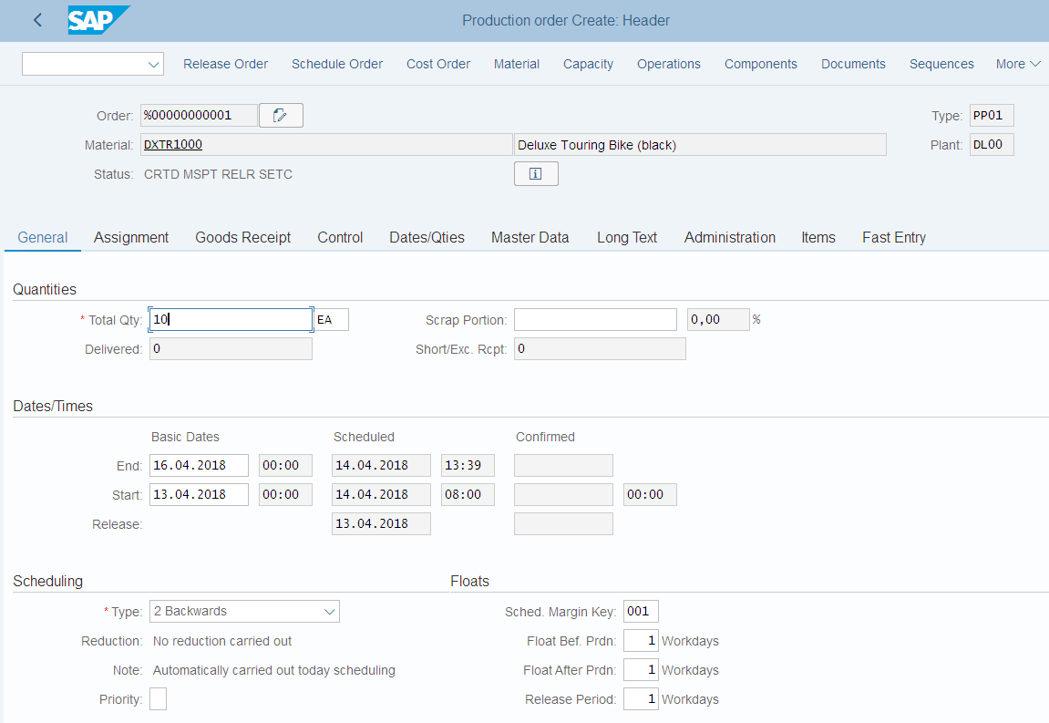
Production Order
How
Components
What
How many
Timeline

Slide 50
Schedule
Calculates the production dates and capacity requirements for all operations within an order
  Determines a Routing
    Operation specific timelines
    Material Consumption Points
  Material Master
    Scheduling Margin Key (Floats)
  Work Center
    Formulas
    Standard Inter-operation Times

Slide 51
Release
Two release processes
  Header Level
    Entire order and all operations are released for processing, order is given a REL status
  Operation Level
    Individual operations within an order are released
    Order is given a PREL status
    Not until the last operation is released does the order obtains a REL status
Automatic vs. manual

Slide 52
Availability Check
Automatic check to determine whether the component, production resource tools, or capacities in an order are available
  Can be automatic or manually executed
  Determines availability on the required date
Generates an availability log
  Displays results of the check
  Missing parts list
  Reservations that could not be verified

Slide 53
Schedule & Release
The time between scheduling and releasing an order is used for company checks and any preparation needed for the processing of the order
Once an order has been released it is ready for execution, we can at this time
  Print shop floor documents
  Execute goods movements
  Accept confirmations against the order

Slide 54
Shop Floor Documents
Shop Floor Documents are printed upon release of the Production Order, examples would be:
  Operation-based Lists
    Time Tickets, Confirmation Slips
  Component-based Lists
    Material Withdrawal Slips, Pull List (consumption list)
  PRT Lists
    Overview of PRT's used with their respective operations
  Multi-Purpose Lists
    Operation Control Ticket, Object Overview
Notes:
List Types
The SAP system differentiates between the following types of lists:
Operation-based lists, for example, time tickets, confirmation slips
Component-based lists, for example Pull List, material withdrawal slips
PRT lists, for example, PRT overview
Multi-purpose lists, for example, object overview, operation control ticket
This type of list can contain information about operations or production resources and tools, for example.
The lists that the system generates and prints refer to all operations, suboperations, components, and production tool and resources contained in a production order.

Slide 55
Material Withdrawal
When a production order is created it references a BOM to determine the necessary components to produce the material
It then places a reservation on each of the components
Upon release of the order (or operation) you can withdraw the reserved materials from inventory
  Reservation is updated
  Inventory is updated
  Costs are assigned to the order as actual costs
Notes:
You can withdraw materials for an order that are not listed as components in the order. These "unplanned withdrawals" cause the actual costs of the production order to be updated.

Slide 56
Confirmations
Confirmations are used to monitor and track the progression of an order through its production cycle
  Confirmation can be done at the operation or order level
Exact confirmation shortly after completion of an operation is essential for realistic production planning and control
Data that needs confirmation include
  Quantities – yield, scrap, rework
  Activity data – setup time, machine time
  Dates – setup, processing, teardown started or finished
  Personnel data – employee who carried out the operation, number of employees involved in the operation
  Work center
  Goods movements – planned and unplanned
  Variance reasons
  PRT usage

Slide 57
Goods Receipt
Acceptance of the confirmed quantity of output from the production order into stock
  Effects of the Goods Receipt
    Updates stock quantity
    Updates stock value
    Changes price stored for future valuation
    Updates production order
  Three documents are created
    Material document
    Accounting document
    Controlling document

Slide 58
Order Settlement
Consists of settling the actual costs incurred in the order to one or more receiver cost objects
  Receivers could include: a material, a cost center, an internal order, a sales order, a project, a network, a fixed asset
Parameters for Order Settlement
  Settlement Profile
    Specifies the receivers, distributions rules and method
  Settlement Structure
    Determines how the debit cost elements are assigned to the settlement cost elements
Settlement Rule
  Automatically assigned on creation of order, the parameters are used to define this rule
    Has one or more distribution rule assigned to it
    Distribution rules define: cost receiver, settlement share, settlement type

Slide 59
Order Settlement
Settling a Production Order to Stock
  Debit posting is made to the Production Order with the value of the material *
  Difference between the debt posting and credit posting is posted to a price difference account
Material
Prod. Order
Price Diff.
80
100
20
* Material Price is determined by the quantity produced times the Standard Price in the Material Master.
Notes:
Since production costs were higher than planned, the additional expenditure negatively affects the operating profit. This means that the profit decreases by the amount by which the actual costs charged to the production order exceed the standard price.
The actual costs charged to the production order affect net income just as the posting of the inventory change at the time of the goods receipt. Since the actual expense was 20 higher than expected, the operating profit is 200 lower than it would have been if production had been at standard cost.

Slide 60
Order Settlement
Costs analyzed
  Primary
    Materials
    External Processing
  Secondary
    Production, Material, and Administrative Overhead
    Labor
Cost Analysis Reporting
  Calculate and analyze planned costs, target costs, and actual costs of the production order.
  Calculate and analyze variances
Notes:
Calculate and analyze planned costs, target costs, and actual costs of production orders and process orders
Calculate or update the work-in-process inventory and the finished goods inventory
Calculate and analyze variances
Transfer data to Financial Accounting (FI)
Transfer data to Profitability Analysis (CO-PA)
Transfer data to Profit Center Accounting (EC-PCA)
Transfer data to Actual Costing / Material Ledger (CO-PC-ACT)

